Slide 1

GROCERY WEBAPP
TEAM MEMBERS:
LATHA SHRI R S(211521205073)
JOTHIKA K(211521205058)
LAVANYA D(211521205075)
MAHALAKSHMI B(211521205078)

Slide 2
Abstract
Grocery Mart is a comprehensive, user-friendly app designed to streamline the online grocery shopping experience.
It offers an intuitive interface, allowing users to easily browse and purchase a wide variety of products across multiple categories, such as household essentials, pantry staples, fresh produce, and snacks.
The app uses smart algorithms to provide personalized recommendations based on user preferences, enhancing the shopping experience.
It also supports coupon applications for additional savings, making shopping both cost-effective and convenient

Slide 3
Introduction
Grocery Mart is an innovative and user-centric online platform that serves as a one-stop solution for all grocery shopping needs. Designed with convenience in mind, Grocery Mart aims to provide a seamless and enjoyable shopping experience for users. The platform offers a wide range of high-quality products across diverse categories, including household essentials, pantry staples, fresh produce, and snacks.
The app features intuitive navigation, making it easy for users to find what they need with just a few taps.
Additionally, personalized recommendations are generated using smart algorithms, ensuring that users are presented with products that align with their preferences and shopping habits.

Slide 4
Proposed System
The app is designed to provide a seamless shopping experience through:
Intuitive Navigation: Simple browsing through categories like household essentials, pantry staples, fresh produce, and snacks.
Personalized Recommendations: Tailored suggestions based on user preferences.
Easy Cart Management: Features like one-click additions, quantity adjustments, and real-time updates.
Convenient Checkout and Delivery Options: Options like same-day delivery, standard, and scheduled delivery​
Hassle-free Checkout: The checkout process is designed to be smooth, with secure payment options and easy management of delivery details. Users can apply coupons and discounts directly in the cart for additional savings.

Slide 5
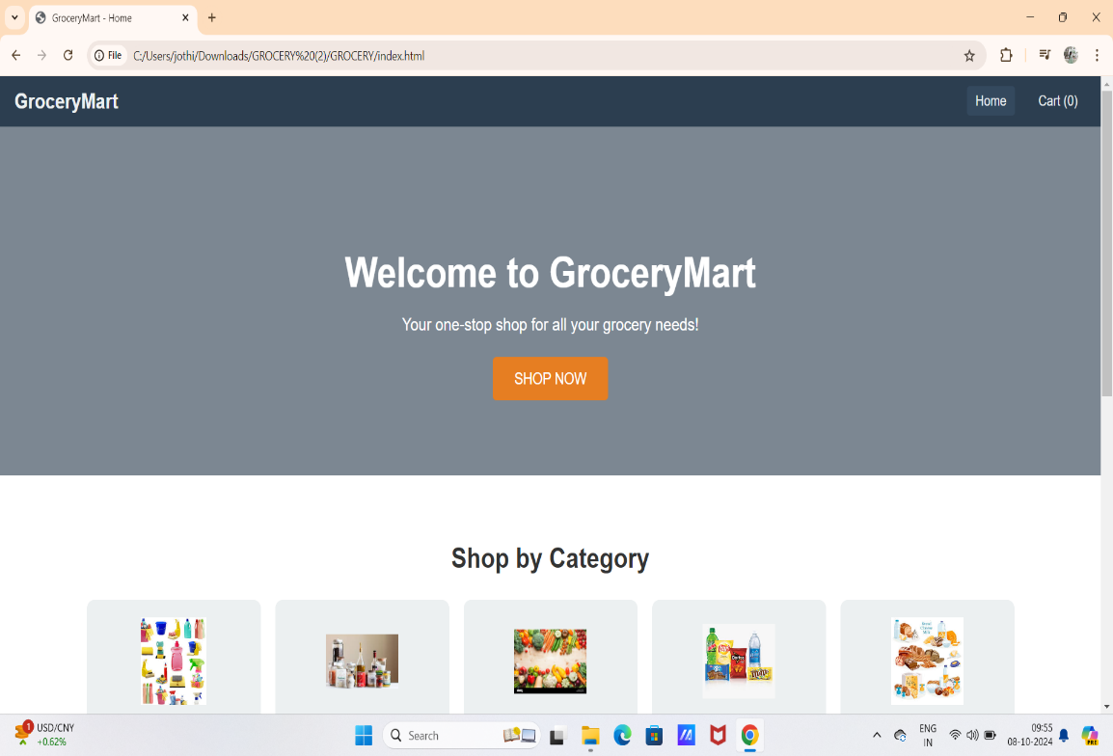
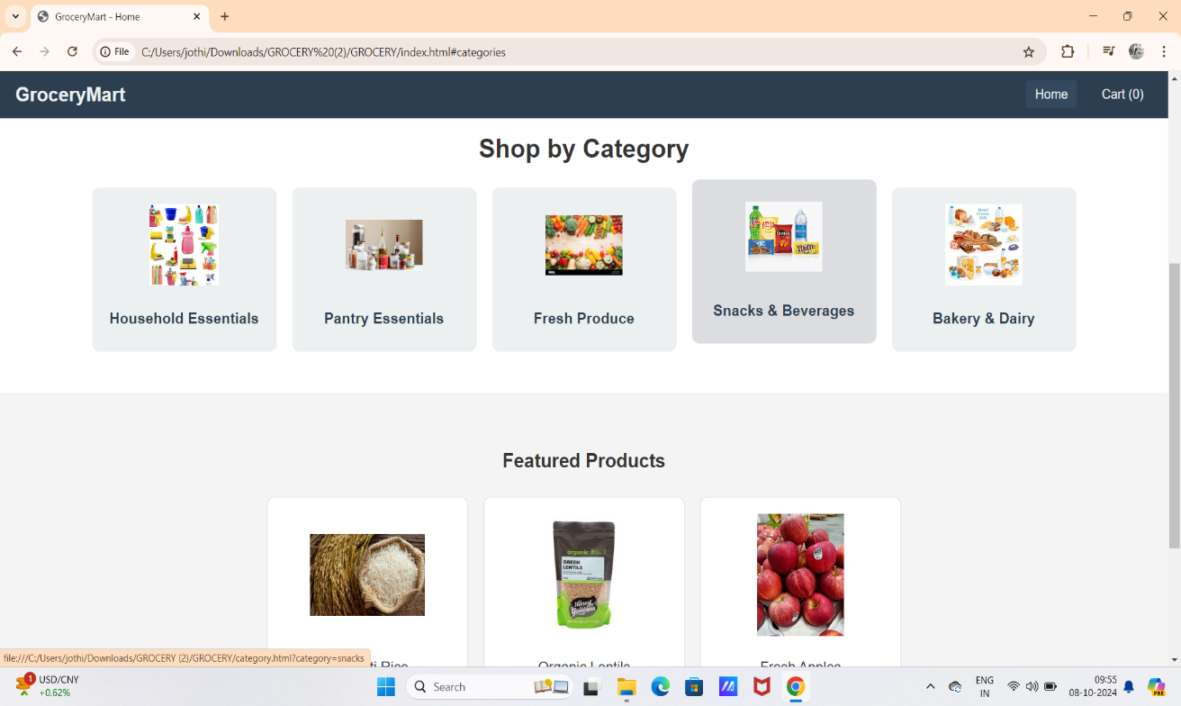
Proposed Model

Slide 6
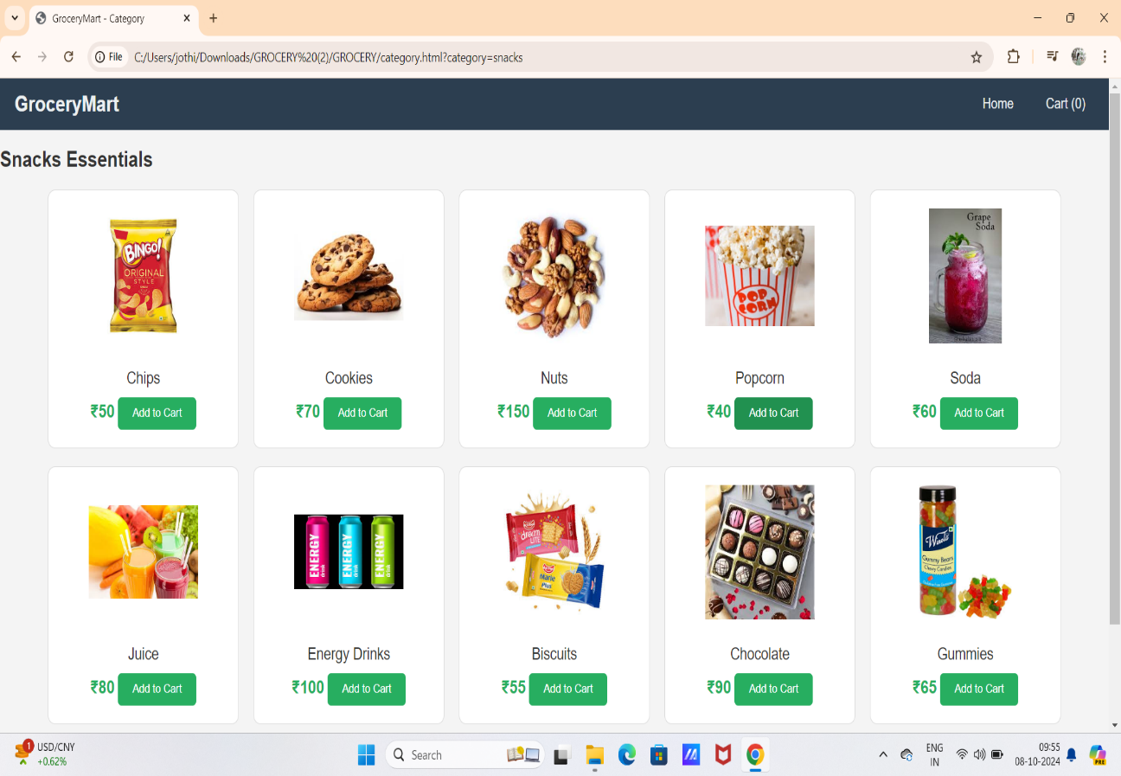
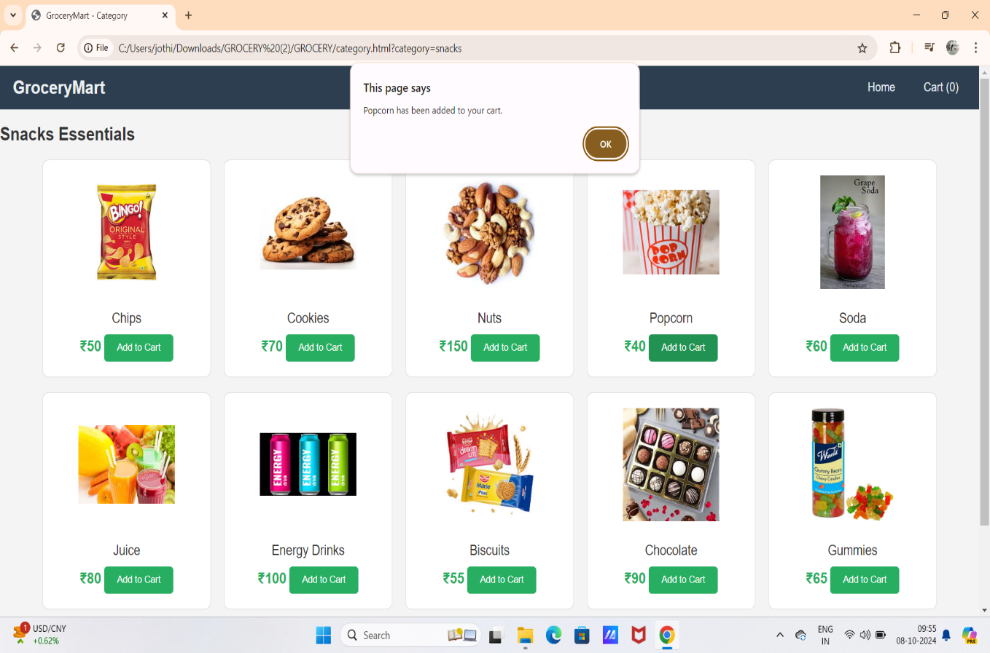

Slide 7
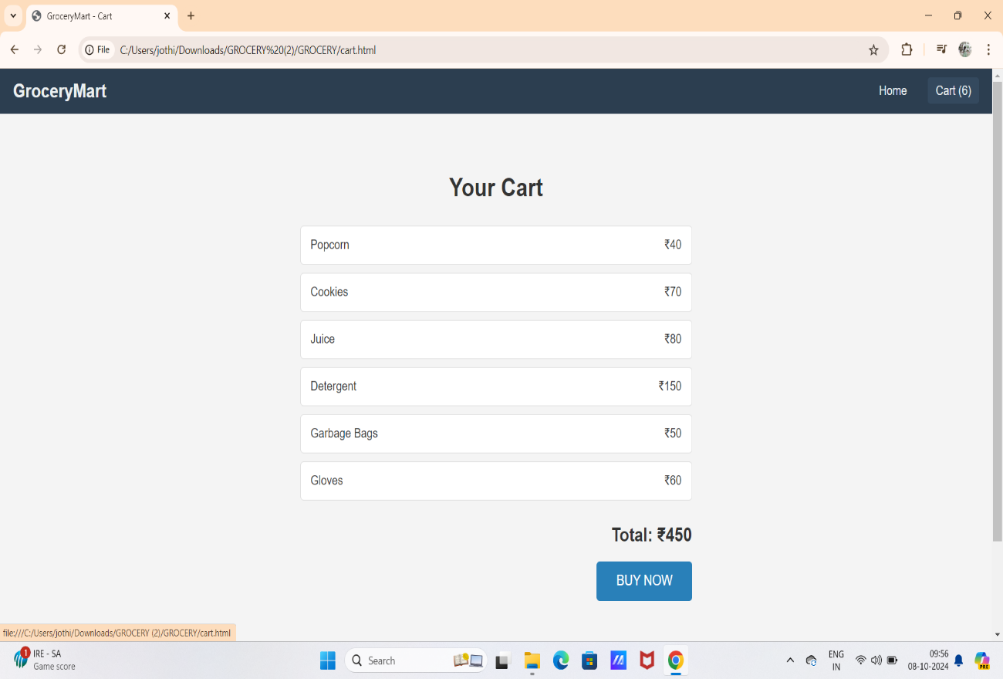
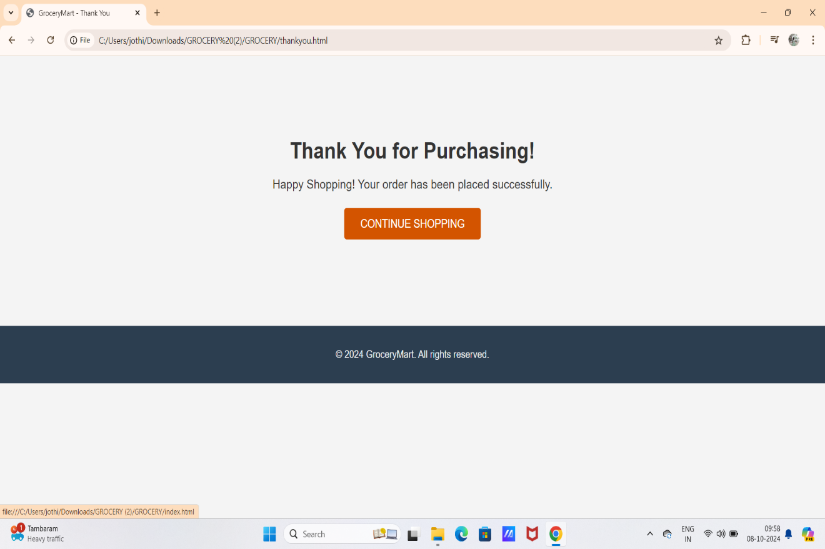

Slide 8
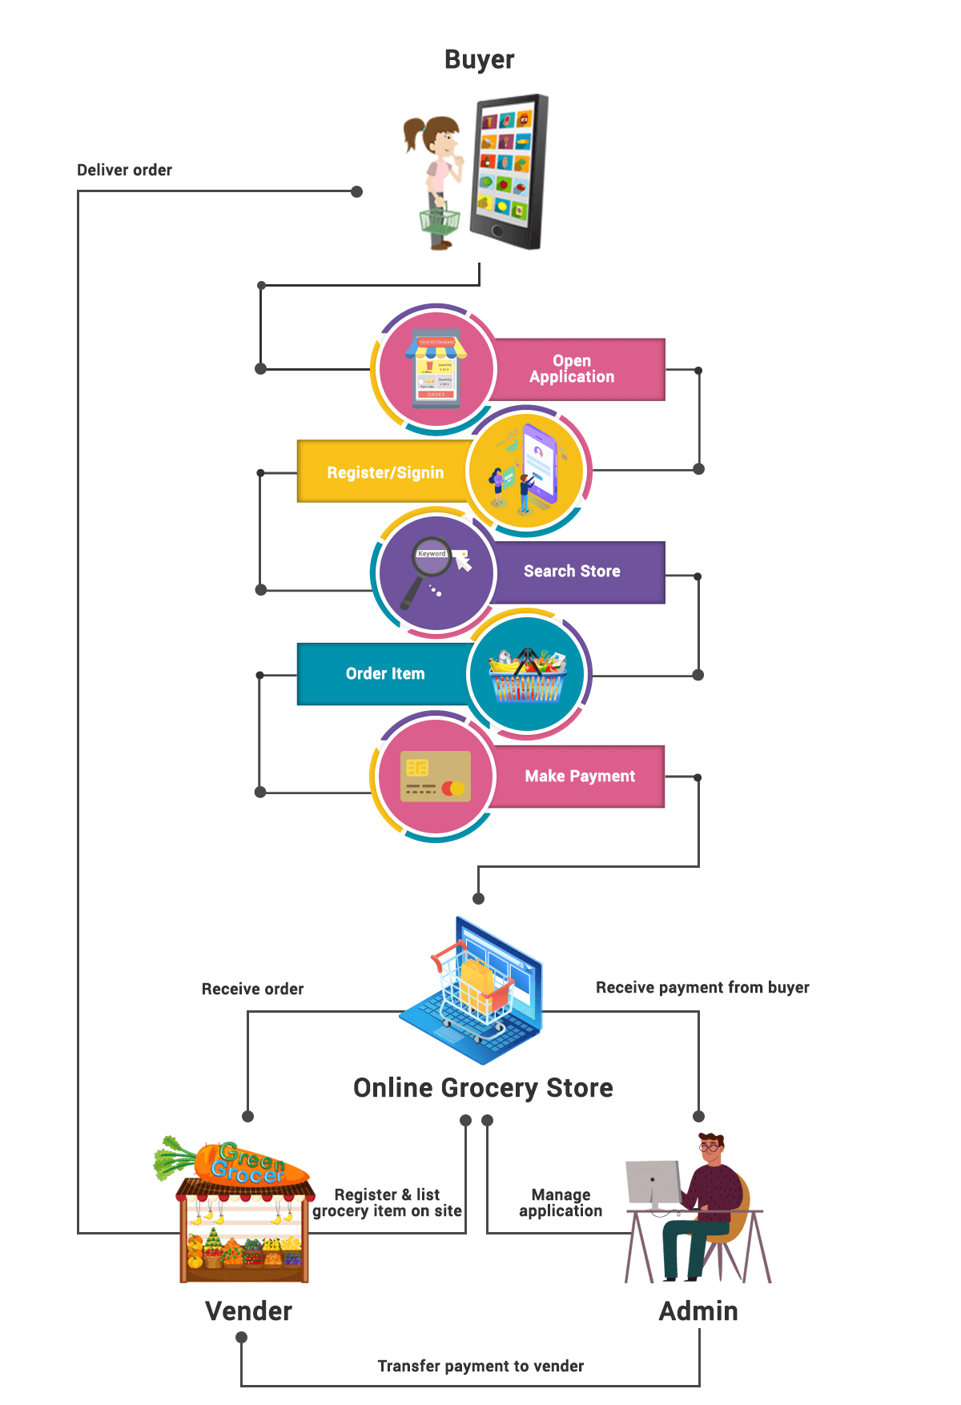
Flow Chart

Slide 9
Grocery Mart stands out for its unparalleled convenience, exceptional selection of high-quality products, and superior customer service. The platform promises to offer a seamless shopping experience that meets the needs of modern consumers. Grocery Mart is more than just an online grocery shopping app—it's a smart, user-focused platform designed to meet the evolving needs of modern consumers. Offering unparalleled convenience through its seamless navigation, personalized recommendations, and flexible delivery options, Grocery Mart ensures a superior shopping experience.
Conclusion

Slide 10
THANK YOU

